Slide 1
Cloud Computing Fall 2020
Notes:
Introduction to the Cloud

Slide 2
Overview
Welcome!
Format of this course
Lectures
Exercises
Project work
Deadlines
Grading

Slide 3

Welcome!
Source: Unsplash/Tyler Lastovich under Unsplash License

Slide 4

Peter Wenzl
Computer Science Master (Dipl. Ing.) TU Wien, 2000
Telecoms Focused Career
Ericsson Austria
mobilkom Austria
Oracle Austria GmBH (CGBU)
Frequentis AG
Linkedin: linkedin.com/in/peterwenzl/
E-mail: peter.wenzl@edu.fh-campuswien.ac.at

Slide 5
Janos Pasztor
Software developer and DevOps engineer background (10+ years experience)
Cloud Focused Career
Docler Group
IXOLIT
Entrecloud
A1
Deloitte
Certified Kubernetes Application Developer
Website: pasztor.at
Linkedin: linkedin.com/in/janoszen/
E-mail: janos.pasztor@edu.fh-campuswien.ac.at

Slide 6

Format of this course
Source: Unsplash/Morning Brew under Unsplash License

Slide 7
Format overview
Integrated course Theory + Practice
Theory Online Lectures (learn at your own pace)
Practice Individual Project Work (in 3 parts)

Slide 8
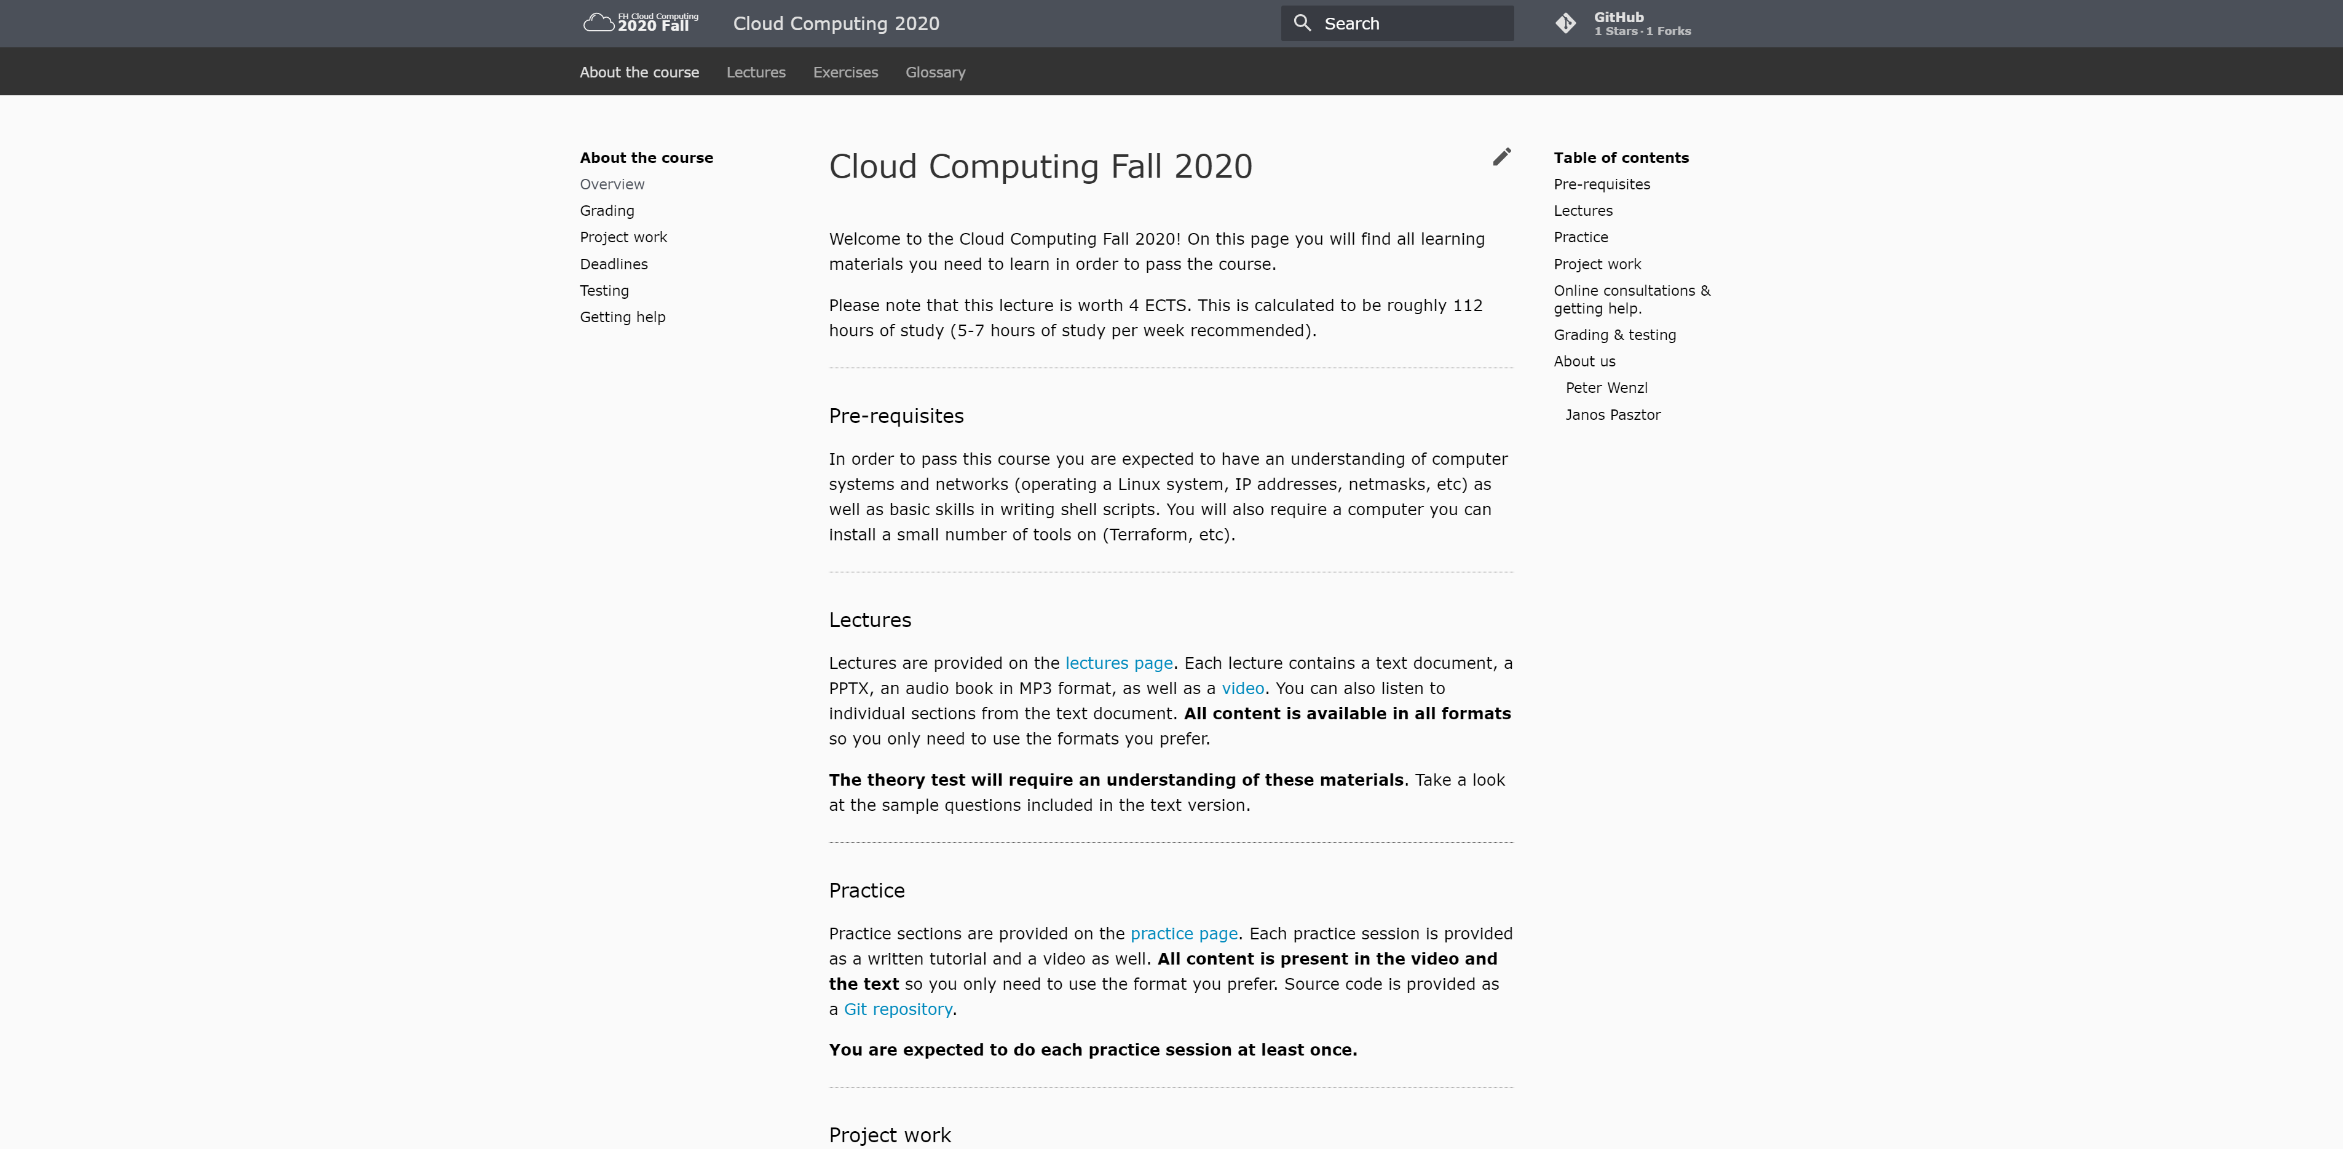
Website
https://fh-cloud-computing.github.io

Slide 9
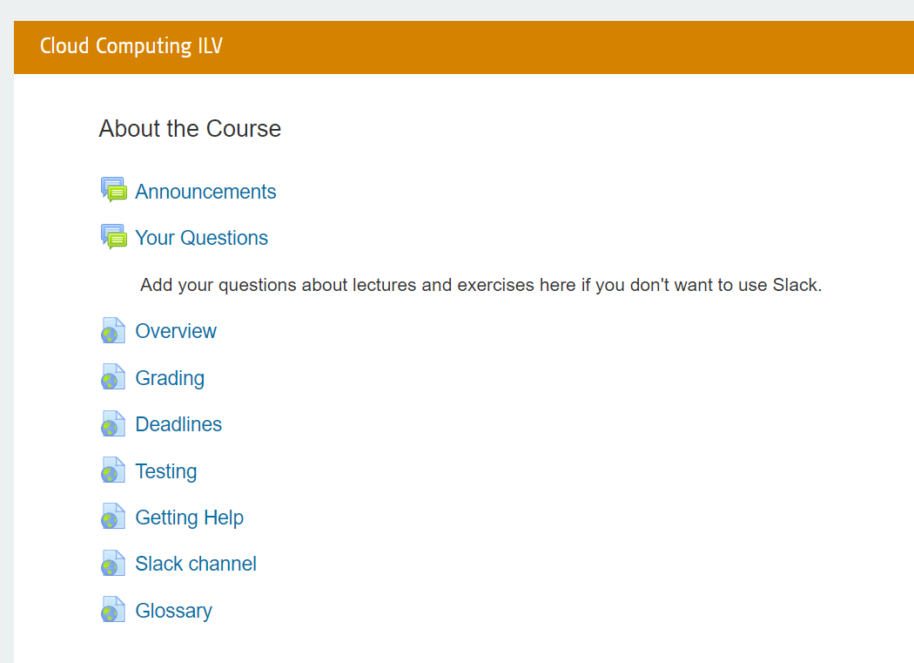
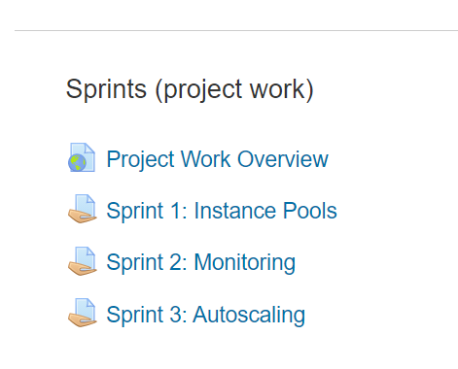
Moodle

Slide 10
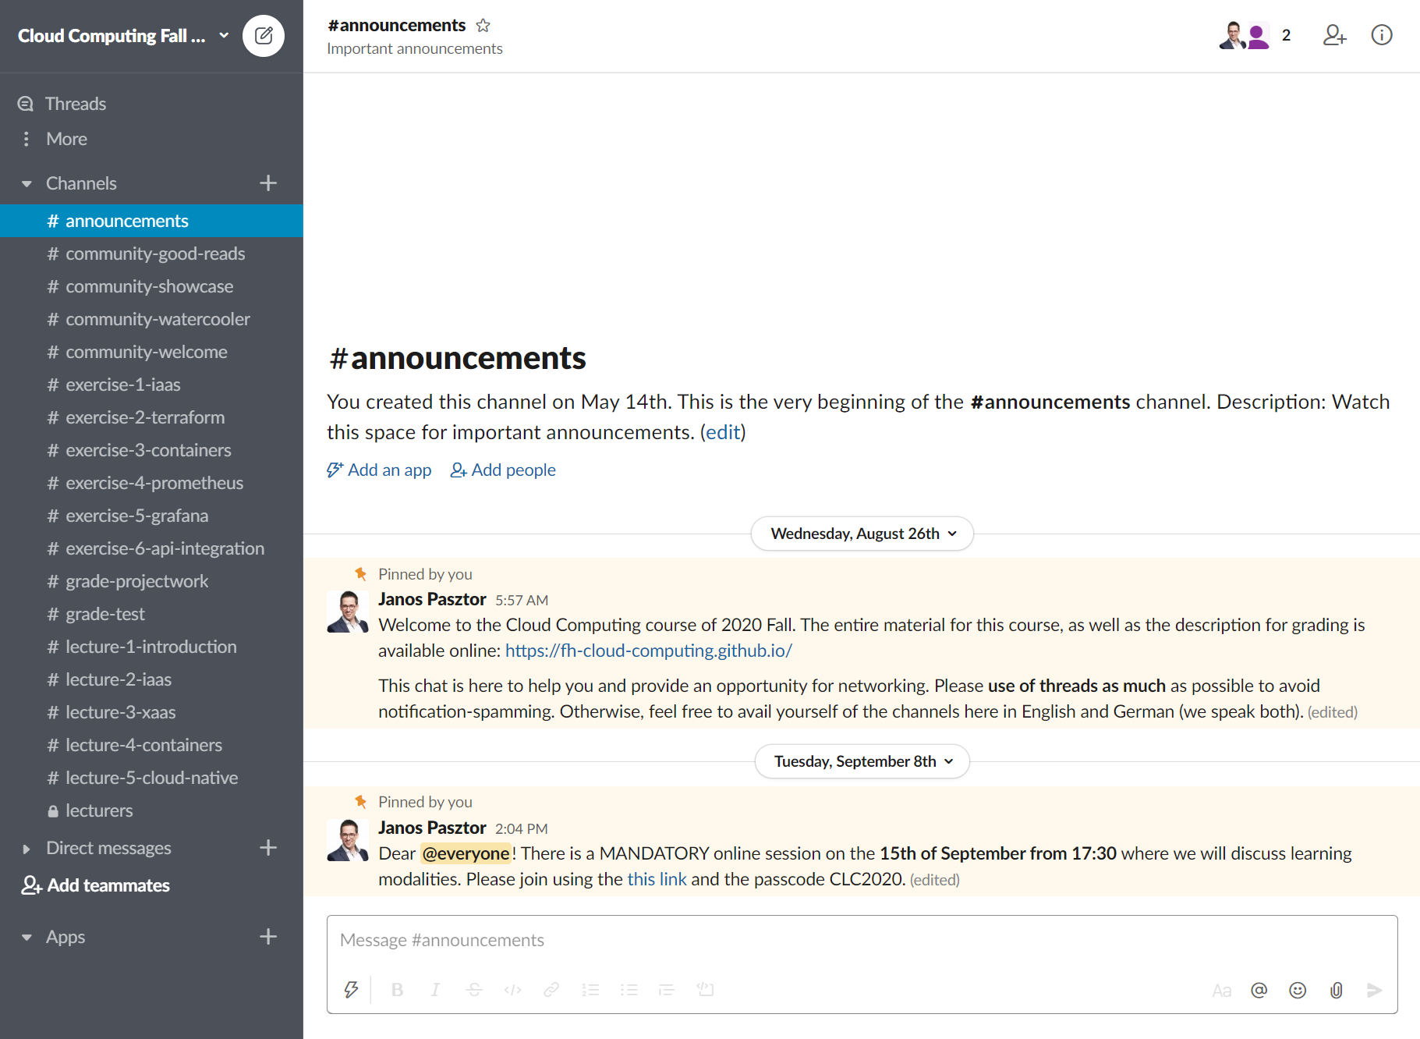
Slack

Slide 11

Lectures
Source: Unsplash/Mohammad Shahhosseini under Unsplash License

Slide 12
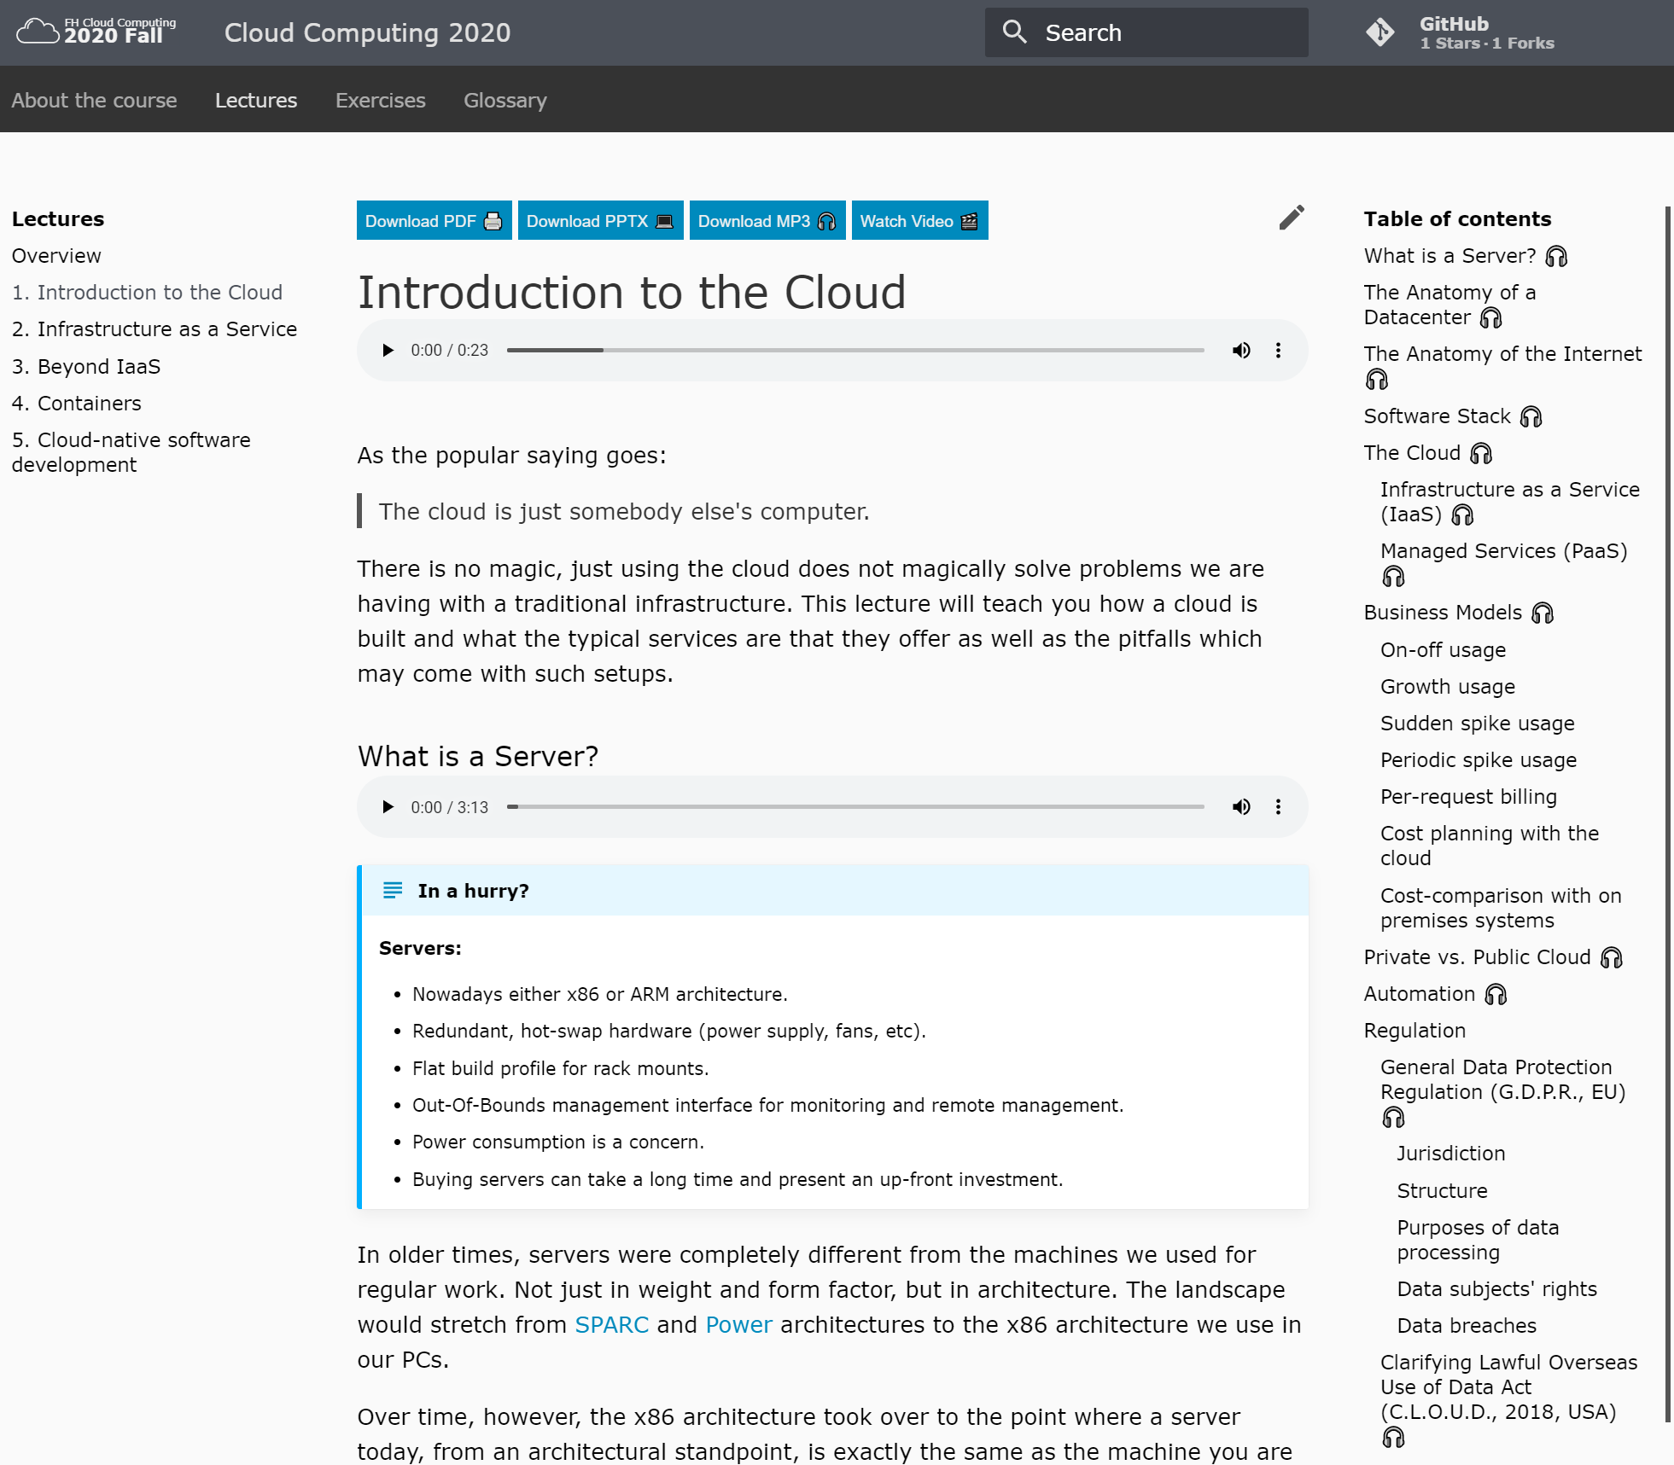
Lecture format

Slide 13
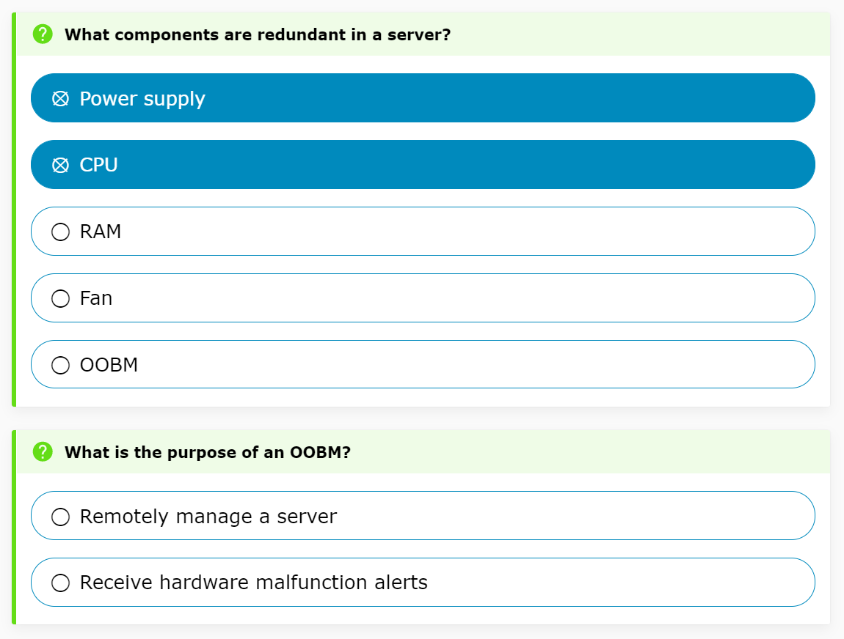
Lecture format

Slide 14
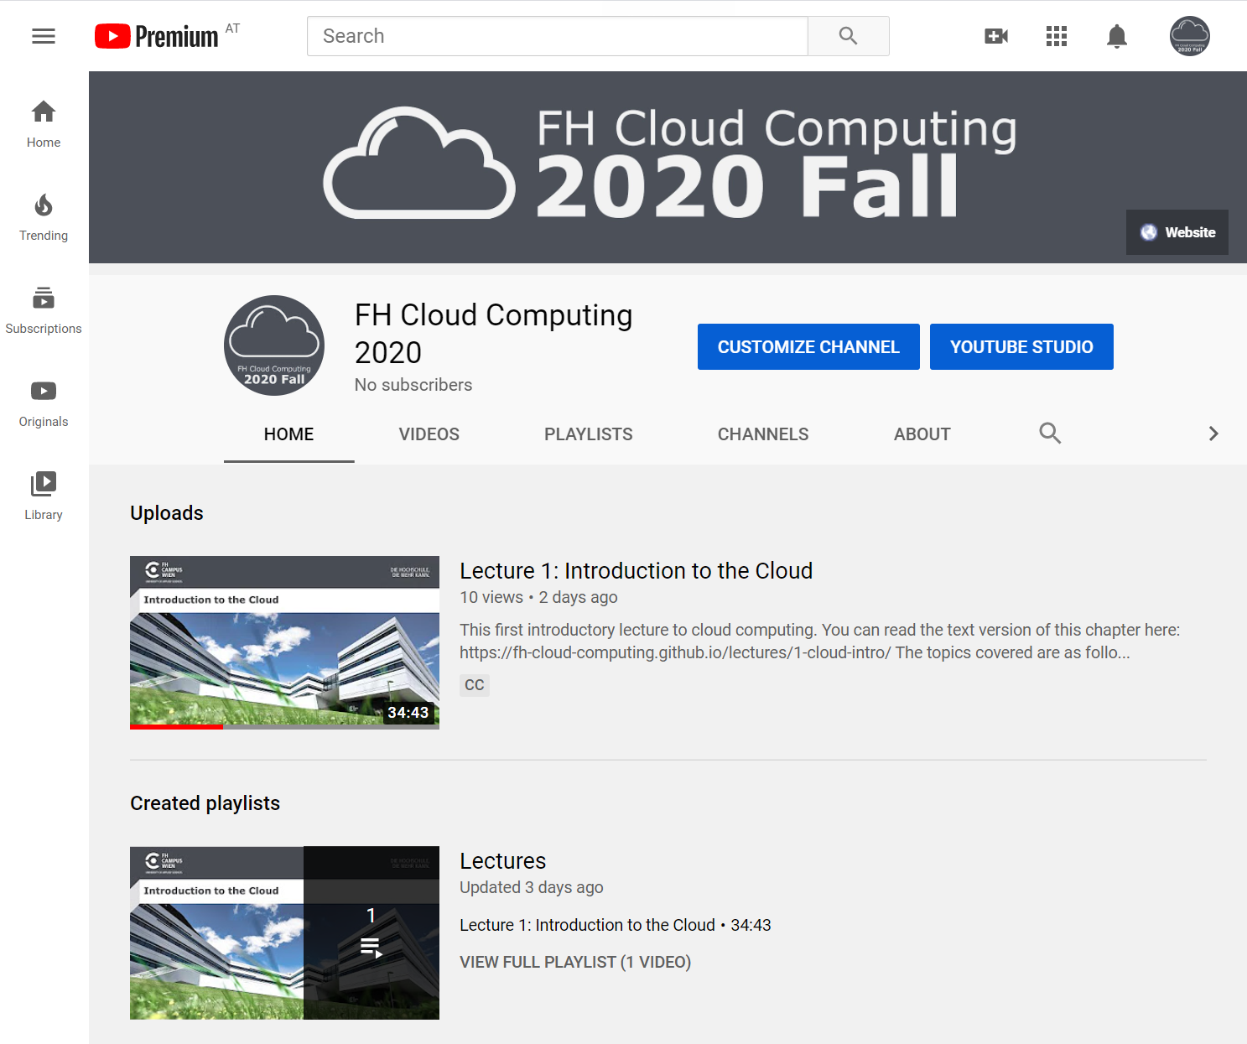
Lecture format

Slide 15
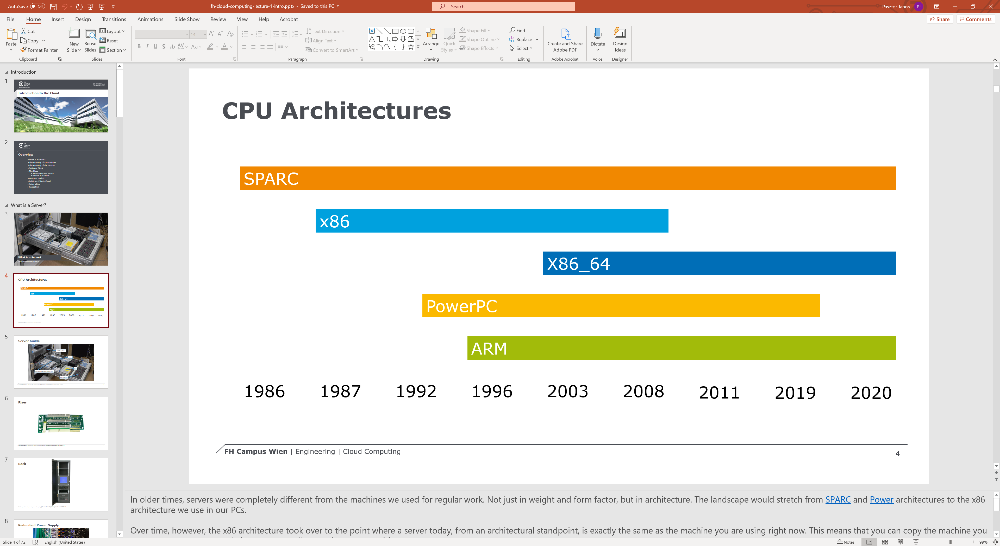
Lecture format

Slide 16
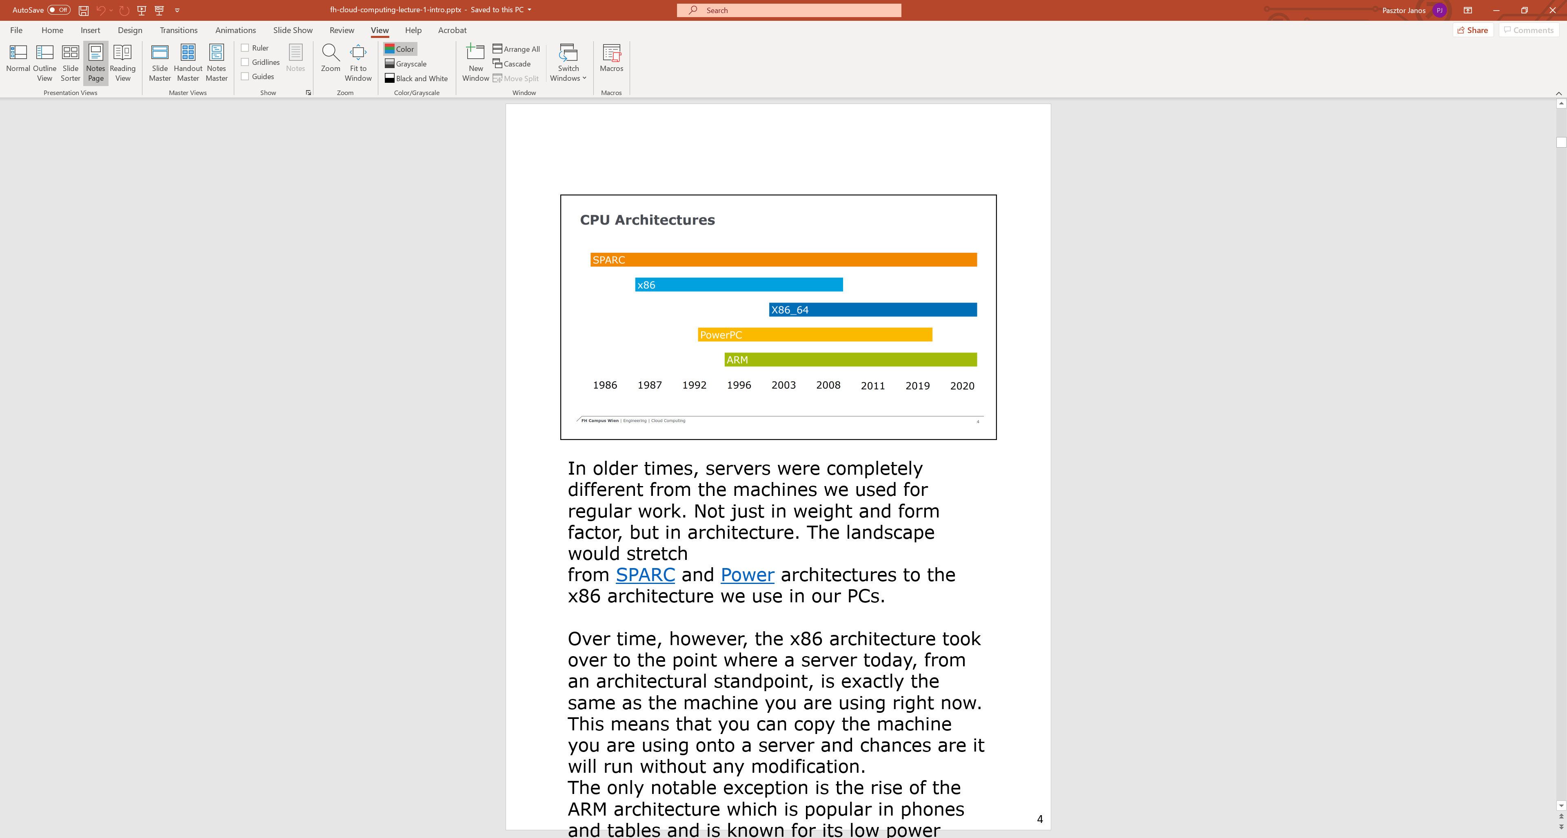
Lecture format

Slide 17

Exercises
Source: Unsplash/John Cameron under Unsplash License

Slide 18
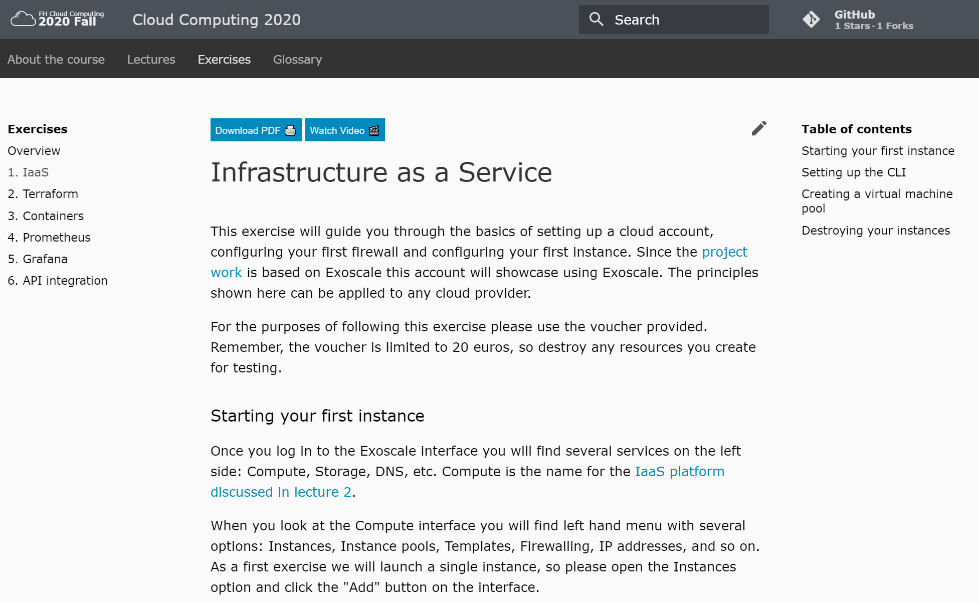
Exercises

Slide 19

Project work
Source: Unsplash/Jo Szczepanska under Unsplash License

Slide 20
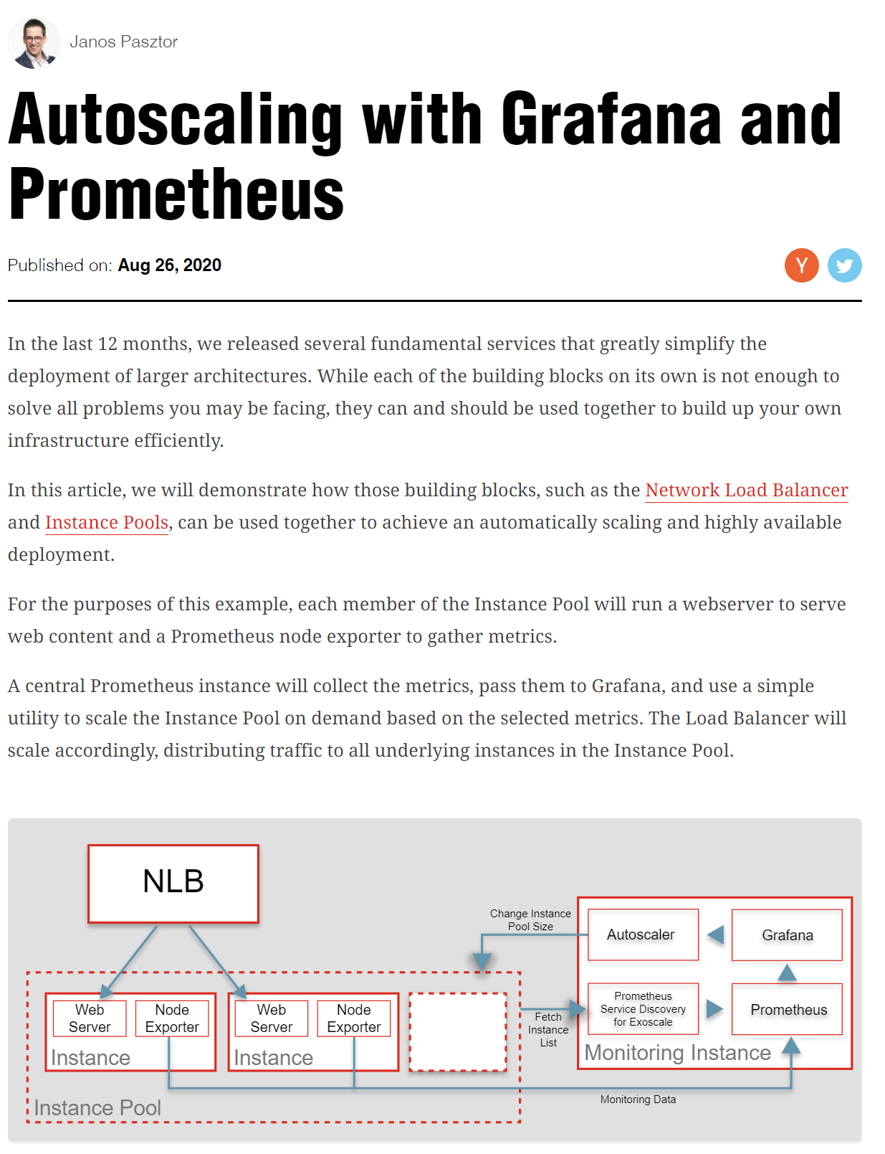
The project

Slide 21
Budget
20 €

Slide 22


Tooling

Slide 23
Architecture
Network Load Balancer
Monitoring VM
SD
Autoscaler
VM
VM
VM
Prometheus
Grafana
Instance Pool

Slide 24
General rules
If you use Terraform, add a Git link in Moodle.
Random solutions will be selected for manual review. Please be prepared to explain your solution.
If you set up manually, contact us for a review appointment.

Slide 25
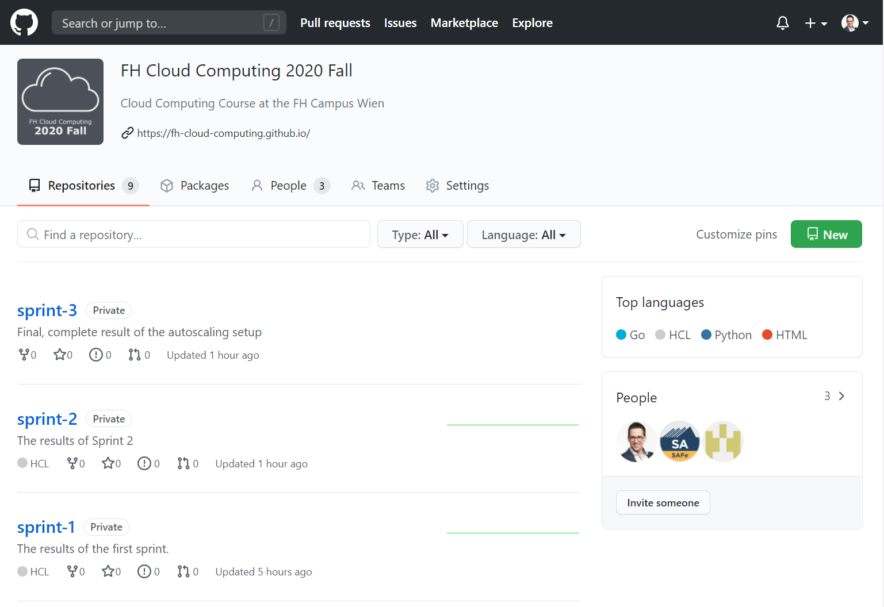
Solutions
Released 5 days after the deadline.
Can be used as a basis for the next sprint.
https://github.com/FH-Cloud-Computing

Slide 26

Deadlines
Source: Unsplash/Kevin Ku under Unsplash License

Slide 27
October 15: Project Work Sprint 1
Set up Load Balancer and Instance pool.
Solution will be released on October 20.

Slide 28
November 15: Project Work Sprint 2
Monitor instances in an instance pool.
Solution will be released on October 20.

Slide 29
December 15: Project Work Sprint 3
Full auto-scaling.
Solution will be released on October 20.

Slide 30

Grading
Source: Unsplash/Annie Spratt under Unsplash License

Slide 31
Overview
55% written exam
45% project work (15% per sprint)

Slide 32
Sprint 1: Instance Pool & NLB
5% for having a working instance pool and NLB
10% for having a fully automated setup using Terraform

Slide 33
Sprint 2: Monitoring
5% for having a working monitoring
5% for having a fully automated setup using Terraform
5% for implementing the Prometheus service discovery yourself

Slide 34
Sprint 3: Autoscaling
5% for having a working monitoring
5% for having a fully automated setup using Terraform
5% for implementing the Prometheus service discovery yourself

Slide 35
Summary
55% written exam
45% project work
15% Sprint 1: Instance Pool & NLB
5% for having a working instance pool and NLB
10% for having a fully automated setup using Terraform
15% Sprint 2: Monitoring
5% for having a working monitoring
5% for having a fully automated setup using Terraform
5% for implementing the Prometheus service discovery yourself
15% Sprint 3: Autoscaling
5% for having a working monitoring
5% for having a fully automated setup using Terraform
5% for implementing the Prometheus service discovery yourself

Slide 36
Marks
100%-90%: 1
89%-80%: 2
79%-70%: 3
69%-60%: 4
60%-0%: 5

Slide 37

Thank you!
Source: Unsplash/Wilhelm Gunkel under Unsplash License

